Slide 1

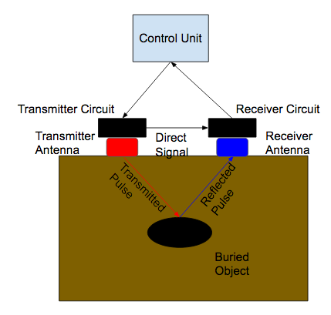
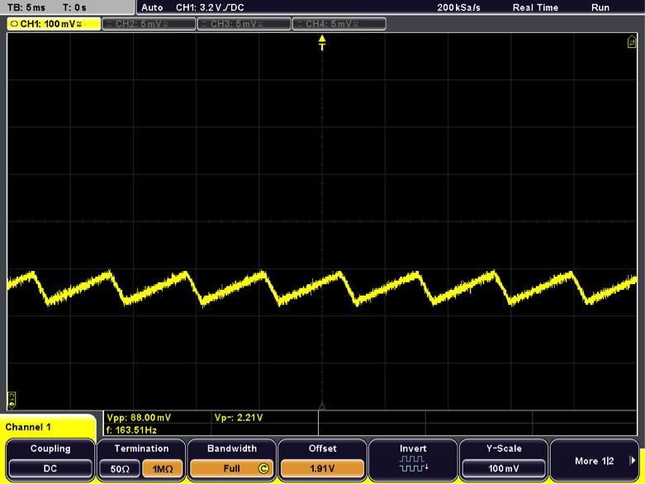
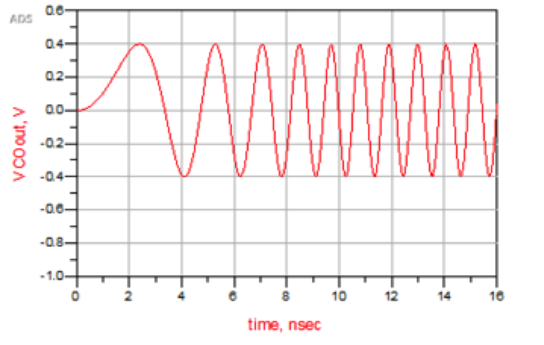
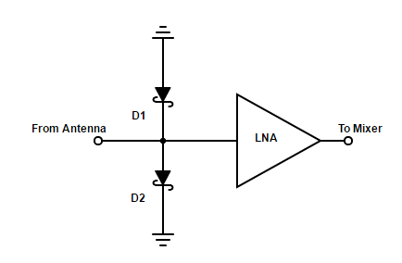
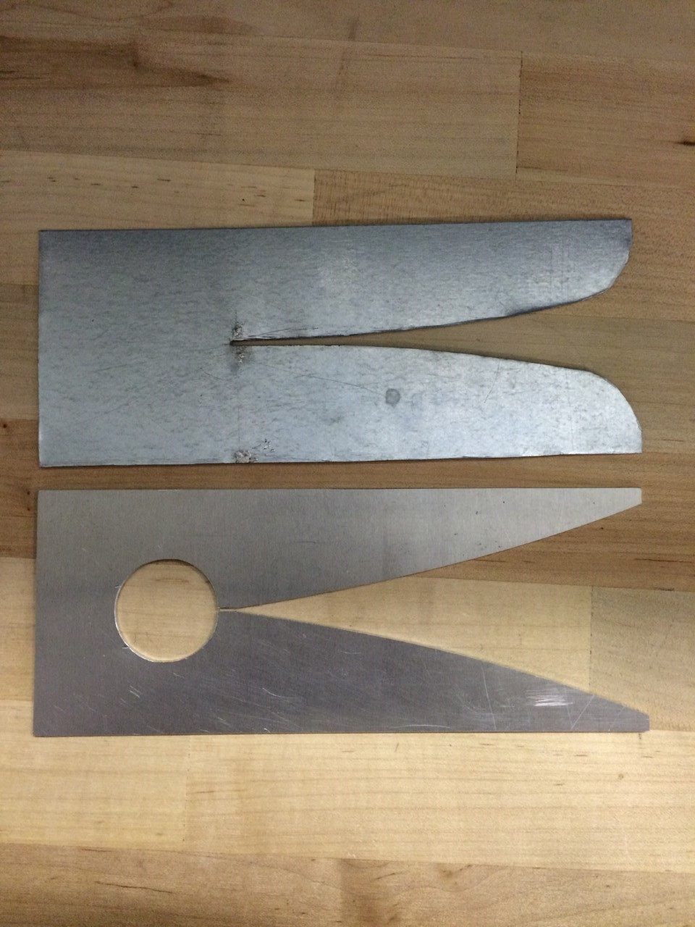
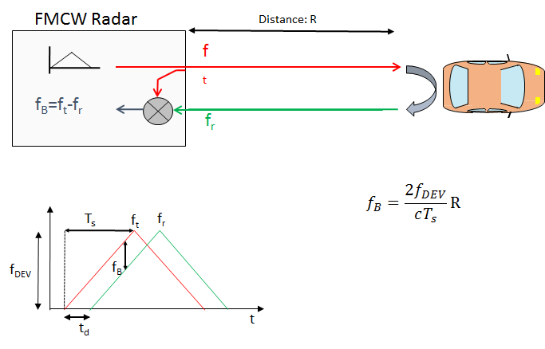
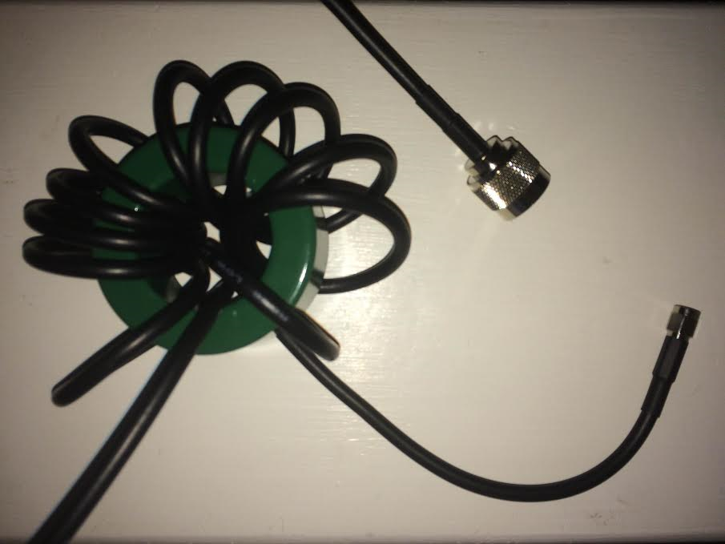
Root Mapping with Ground Penetrating Radar
Sponsor: Dr. Mark Everett (GEOP)
Professor: Dr. Chadi Geha TA: Neal Hollingsworth
Team members: Tyler Castro, Coy Coburn, Daniel Miller, Michael Turner
Abstract/Overview
A ground penetrating radar system (GPRS) detects objects beneath the surface by measuring a reflected electromagnetic wave and matching the reflected signal with the incident wave. After data processing, an object's depth and even the object’s material can be determined. This helps geophysics to map root growth over a period of time in a nondestructive way. Unlike other GPRS, our system uses higher frequencies (2.415-2.425GHz) in order to improve resolution.
Signal Generation
(Linear Frequency Modulated Waveform)
A linear frequency modulated waveform is generated using a function generator and a Voltage Controlled Oscillator (VCO). This type of waveform is generated so that the frequency domain can be utilized versus the time domain. This is important in that as a signal passes through different media, the frequency of the signal remains constant. This allows the frequency to be matched on the received side so that time and amplitude can then be measured more accurately versus the time domain.
Receiver Protection and LNA
Before the signal is passed to the mixer it is conditioned to make use of the whole dynamic range of the AD converter. This is done by passing the signal through an LNA (Low Noise Amplifier). To protect the LNA from high power spikes, such as ones generated by the air to ground reflection, a schottky diode clamp is added between the LNA and the antenna. The schottky activation range is between the LNA compression point and the LNA maximum input power. LNA compression point is calculated by taking the difference between the output power at 1dB compression and the gain obtained by the LNA
Figure 4: Function Generator output
Figure 5: Linear Frequency Modulated Waveform
Figure 1. General Concept of GPRS
Reflected Signal Mixing and Filtering
Once the Rx has been amplified by the LNA, it must be mixed with the original baseline transmitted signal. Feeding the Rx into the RF input and the Tx into the LO port, an IF signal is produced. The signal is output in differential components to provide noise immunity as well as a cancellation on even-order harmonics. Calculations illustrate an expectec IF signal of 200kHz.
The IF outputs are passed through a filtering stage for image rejection. Cutoff frequencies of 250 kHz are chosen to not only prevent the up conversion image to pass, but also to protect from any unexpected IF spikes during changes in rising and falling RF/LO frequencies.
Vivaldi Antennas
Two Vivaldi Antennas set to transmit at a frequency between 2.4025 - 2.4775 GHz. The antennas operate as a slot hole that increases in width exponentially, eventually matching the impedance of the signal with air. Ferrite cores were used to create RF chokes which acted as baluns for the system, allowing for the unbalanced coaxial cable to transition into the balanced antenna.
Figure 7. Receiver Protection and LNA circuit
AD Conversion
The filtered IFP and IFN are passed through the ADC driver for buffering and adjusting amplitude before reaching the ADC. A AAF is also included to ensure the cutoff frequency from previous stages is still entailed. Finally, an ADC with at least twice the sampling rate of the Nyquist frequency, in this case the bandwidth, is used to get the needed samples to accurately convert the analog signal into its digital counterpart.
Receiver Conversion Subsystem
Figure 6. Frequency vs Time representation of LO signal compared to the RF signal
Schottky
LNA
Rx MIXER
LPF
ADC Driver
AAF
Figure 2. Vivaldi antennas, version 1 (top) and version 2 (below).
Figure 3. Ferrite core with coaxial cable wrapped around it, creates reactance along the outside of the cable
RF
LO
IFP
IFN
ADC
Power Splitter
Figure 8. Receiver subsystem block diagram

